Slide 1
Airbnb Europe
Hits and Flops - Trends and Data
By Εδώ_Πολυτεχνείο+ Team

Slide 2
DataFrame
Kaggle Airbnb Database
Qualitative and Quantitative parameters
SuperHost or not?
10 major European cities
21 parameters/factors included from ratings (cleanliness, rest_index, city, long/lat, type of room, capacity…)

Slide 3
ML Approach
DataFrame up to usual kaggle standards…
What makes a SuperHost?
Can we predict them? How reliably?

Slide 4
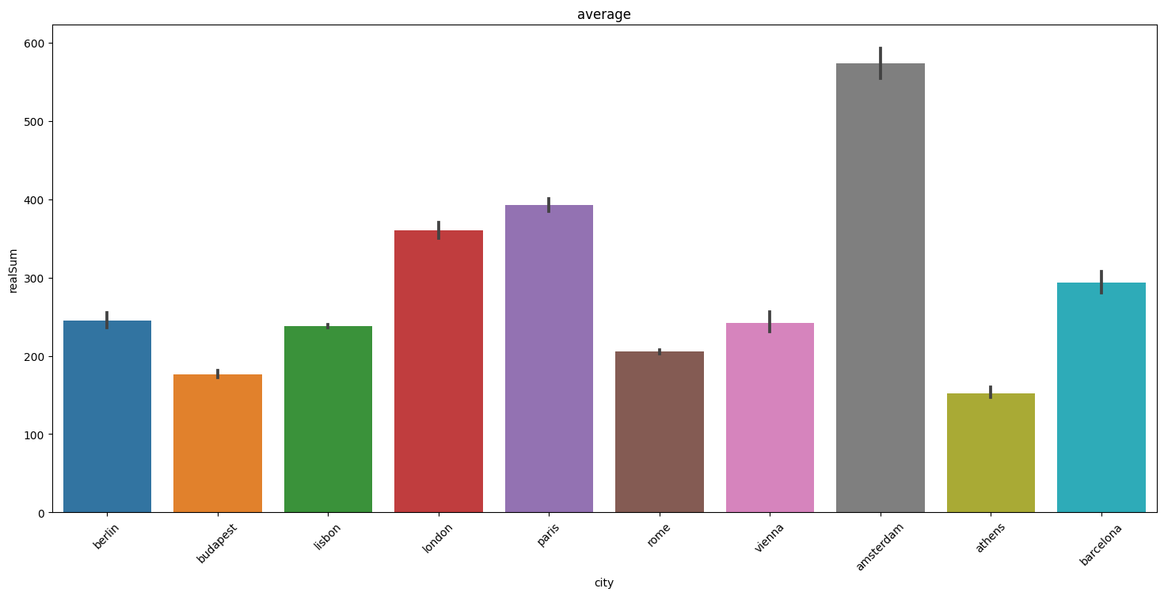
Average price of AirBnB venue per City
Price mapping
Notes:
Emerald Sun and Freak Show rank high for loudness and scored hits.

Slide 5
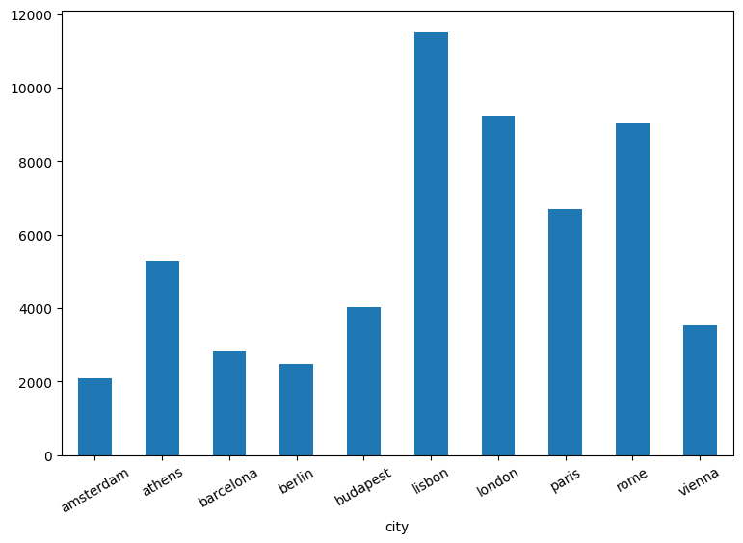
… and Supply

Slide 6
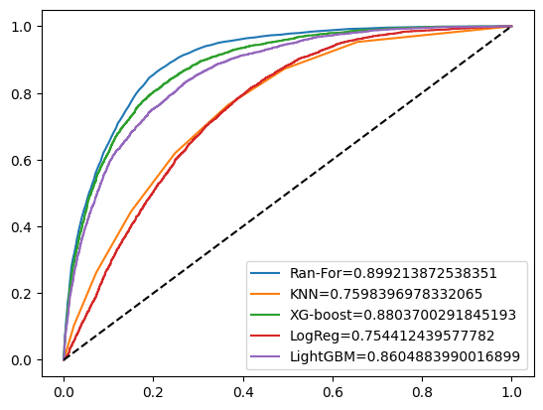
Model Performance
Notes:
Artists like Christina Aguilera, Justin Timberlake, Katy Perry rank high in the danceability sector.

Slide 7
Factor Analysis Results
Based on MRMR analysis
Guest satisfaction overall
Cost of stay (realSum)
Cleanliness
Multiple rooms or not
Location
Business-oriented or not
were the determining factors making or breaking a SuperHost (high ratings all around…)

Slide 8
Model Analysis
Surprisingly, ML models had considerable trouble initially. ML is not a “silver bullet”, even for a relatively simple problem.
RandomForestClassifier proved the most versatile and capable, confirming its widespread use as a model benchmark (capacity to avoid overfitting-handle outliers).
SMOTE and upscaling had a favorable impact upon results.
Hyperparameter tuning to follow...

Slide 9
Conclusions
Performance
Guest satisfaction overall
Cost of stay (realSum)
Cleanliness
Multiple rooms or not
Location
Business-oriented or not
were the determining factors making or breaking a SuperHost (high ratings all around…)

